Slide 1
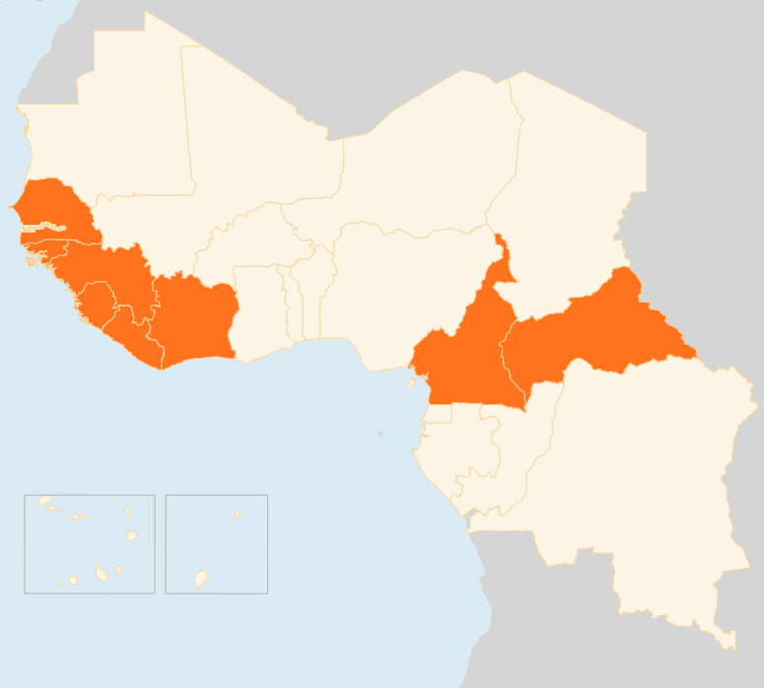

8 – 15 September 2015
CAMEROON
AT LEAST EIGHT KILLED IN TWIN BLASTS
On 13 September, at least eight people were killed and 28 others injured in twin bomb attacks in Kolofata, a border town in Cameroon’s Far North region where Boko Haram insurgents have conducted numerous raids. The attacks were carried out by two assailants, according to media reports.
CENTRAL AFRICAN REPUBLIC (CAR)
TWO KILLED IN GRENADE ATTACK
On 9 September, unidentified gunmen on motorbikes threw grenades into crowds of people in the 6th district of Bangui, killing at least two people and injured many others The attacks occurred at a time of improvement of the security situation and recovery of economic activities in Bangui.
CONCERN EXPRESSED OVER EVICTION OF IDPs
On 15 September, the Humanitarian Coordinator and the humanitarian community in the Central African Republic publicly expressed serious concerns on the forceful eviction of 114 internally displaced persons (IDPs) from the Saint Jean Gabaladja site in Bangui, occurred on 12 September.
COTE D’IVOIRE
ONE KILLED IN VIOLENT POLL PROTEST
On 10 September, one person was killed and property destroyed during clashes between opposition protesters and police in several Côte d’Ivoire towns. The protests, which were the first major eruption of violence ahead of the 25 October presidential poll, came after the Constitutional Court released a list of 10 candidates cleared to run in the election.
SENEGAL
CHIKUNGUNYA VIRUS REPORTED
On 9 September, the Senegalese government notified WHO of cases of chikungunya in the south-eastern Kédougou region. The virus began circulating on 27 August. Of the 14 suspected cases, 10 turned out positive for the virus which is transmitted to humans by infected mosquitoes and causes fever and severe joint pain.
EVD REGIONAL
4 NEW CASES IN SIERRA LEONE
On 11 September, Sierra Leone reported a new confirmed EVD case, a 16-year-old girl from the northern Bombali district where no case has been reported for over six months. 690 inhabitants have been put under quarantine On 7 September, in Kambia district also in the north, three new cases were reported. All three are relatives of a woman who died of Ebola on 28 August, becoming the first death a week after the then last known EVD patient in Sierra Leone was discharged from hospital. No new cases were reported in Liberia although there are concerns over low reporting of suspected cases. In Guinea, for the first time since the outbreak, no new cases have been confirmed since 1 September.
SENEGAL
10
CASES OF CHIKUNGUNYA
CAMEROON
8
KILLED IN BOMB ATTACKS
CAR
2
KILLED IN GRENADE ATTACK
EVD REGIONAL
COTE D’IVOIRE
4
NEW CASES IN SIERRA LEONE
1
KILLED IN POLL PROTEST
Creation date: 16 September 2015
Map data sources: UNCS, DevInfo, OCHA.
The boundaries and names shown and the designations used on this map do not imply official endorsement or acceptance by the United Nations

